Slide 1


Main Street Tax Credit Incentive Program (MSTCIP)
Overview and example

Slide 2
Disclaimer
I am not a tax advisor. The examples here are based on IRS tables and my own calculations using them as well as my own experience. Your tax advisor may provide different guidance than mine and you should consult them to see how your situation may be different.

Slide 3
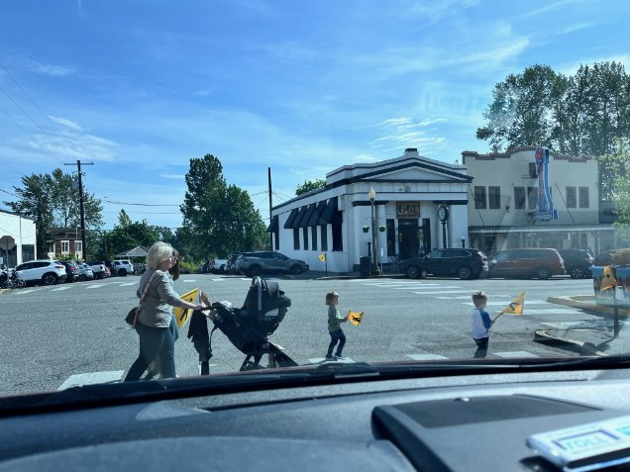
Our Mission
Our mission is to support those who live, work, and play in the Downtown Historic District through visionary leadership, preservation-focused efforts, outreach, and fostering community in the heart and soul of the city of Snohomish.

Slide 4
Vision for our District
Downtown Snohomish is a timeless, one-of-a-kind place full of diverse, surprising, and almost magical experiences enjoyed by individuals, families, and friends from near and far. There is a genuine small town feel that is built on thriving small businesses where owners and staff connect with locals and visitors alike. It is welcoming and familiar yet discoverable which draws people back time and time again. The past is preserved but the present is welcomed, and we innovate for the future.

Slide 5
Strategic Relationships & Priorities
Working with Landlords to help them find the right types of businesses that will enhance the downtown experience and be successful long-term tenants.
Supporting our business owners by advocating for a vibrant downtown that is small business focused and well-balanced between retail, food, experiences and services. We are their indispensable partner and expert in creating this downtown by cultivating businesses and ensuring the success and vitality of the entire district.
Building community through our events, placemaking, and programs to support relationships, families, and connections.
Promoting historic downtown Snohomish both near and far and encouraging one-of-a-kind experiences that draw people back again and again.
Government partnerships – building relationships at all levels to ensure that we are harnessing the resources and building the support needed to shape the downtown we envision.
Coordinating with other non-profit organizations that touch our district to help prioritize work and leverage each other’s resources for the benefit of our downtown.
Creating a stable financial and engaged volunteer organization that can support the work we have before us.

Slide 6
What and Why?
The State of Washington allows businesses to essentially re-direct their B&O taxes to their own communities to improve economic vitality, foster community, and promote historic preservation.
  You have the power to direct tax money you already have to spend back into the community you do business in - directly benefitting you and your neighbors
To do this, you have to have an accredited Mainstreet Community to donate to (which the HDSA is).
Your donation goes directly to the HDSA, which is 100% dedicated to the people who live, work, and play in the historic downtown district.
  There is no other organization, including our city government, that can say this.
As a non-profit, we cannot function without donations and depend on the support of our local community.

Slide 7
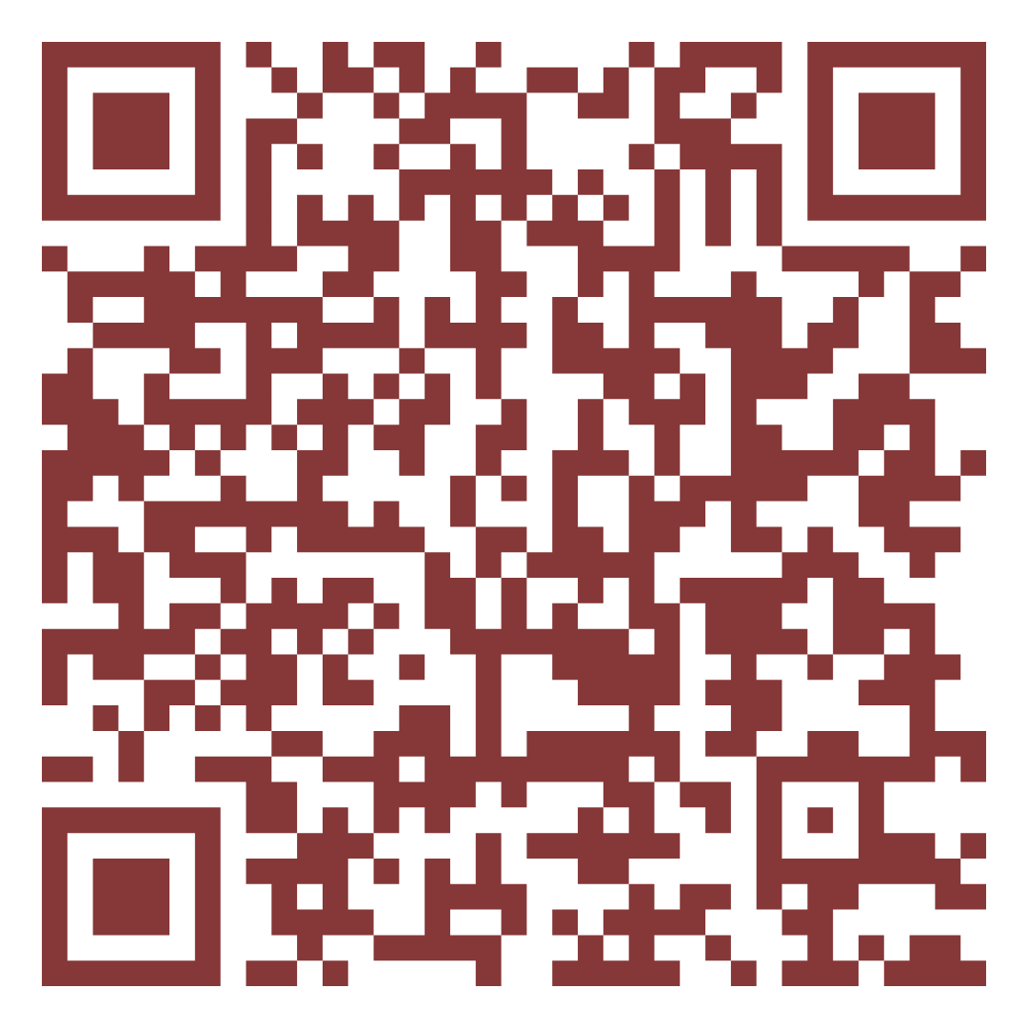
MSTCIP
Redirect your B&O taxes to your downtown!
- Receive a tax credit equal to 75% of your donation on your B&O tax dollars
- Your donation is to a 501(c)3 which means your donation may also be a tax deduction on your federal tax return
  Double whammy!
- You can make your pledge today
- Pledges need to be paid in full by November 1st

Slide 8
Example of how it works (in words)
1. Estimate how much B&O Tax you will pay in 2026
  If you think your year-over-year sales will be consistent, just use the last 12 months of B&O taxes
2. Determine your donation amount. Because 75% of your donation comes back to you as a credit, divide your 2026 estimate by .75, and that should be your maximum donation amount to fully cover your expected B&O tax liability.
3. Make you pledge on the DOR website and remit your donation to HDSA by November 1 to be eligible for your credit
  Because this is a donation that gives you a credit for next year on your B&O taxes, you will need to make sure that you have the capital by November 1st to pay your pledge.
4. Beginning in December, you will be able to use the credit on your 2026 B&O taxes (since they are paid in January)
5. For your federal tax return, you will be able to use this donation as a deduction on your federal taxes.

Slide 9
Example of how it works (in numbers)
1. Estimated 2026 B&O Taxes: $3,000
2. Donation amount: $3,000/.75 = $4,000
3. Pay your donation to HDSA by November 1st: $4,000
4. On December 1, you will have a $3,000 credit in your DOR profile
5. When you file your taxes by April 15th, you will be able to claim your $4,000 donation as a deduction.
  How much will a $4,000 deduction lower your tax bill? The answer is, it depends! It depends on if you itemize your deductions. Use this calculator to help you: Charitable Giving Tax Savings Calculator | Fidelity Charitable
  It’s possible, if your marginal tax rate is 34% or higher, that the MSTCIP will be even more beneficial for you.

Slide 10
Continued
2026 Estimated B&) Taxes: | $3,000 | Cost to you
Donation: | $4,000 | $4,000
B&O Tax Credit (75%): | $3,000 | $4,000-$3,000 credit = $1,000
Federal Tax Deduction (Tax rate of 24%): | $4,000*.24 = reduces tax bill by $960 | $1,000 - $960 = $40. Said another way, your $4,000 donation actually only cost you $40
Federal Tax Deduction (Tax rate of 32%): | $4,000*.32 = reduces tax bill by $1,280 | $1,000 - $1,280 = $280. Said another way, your $4,000 donation actually helped you SAVE $280 and cost you NOTHING. You made money by helping your community!
Click here to see your tax rate: https://www.irs.gov/filing/federal-income-tax-rates-and-brackets

Slide 11
How about next year?
For 2026, you will repeat the process for 2027. Just be sure to have the capital to pay your pledge by November 1st.
Even though you have until November 1st to pay your pledge, because the MSTCIP program has a $ cap, it is best to make your pledge early before the pool gets used up (so the sooner the better).
Donors can pay their pledges monthly, quarterly, or in a lump sum.

Slide 12
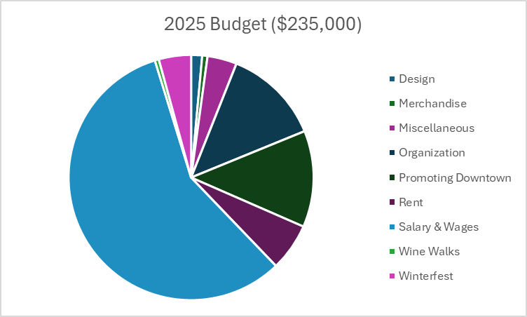
How would your money be used?
The salary & wages of our two staff members is the single biggest cost to our non-profit. However, 100% of their time is dedicated to the success of our downtown in supporting businesses, property owners, residents, and visitors and creating a district where businesses thrive and connections are strengthened through community.
Your support is essential at helping our organization increase its impact this year and beyond.
We hope you will join us in our mission.

Slide 13
What could your money be used for?
If we had additional funds, here are areas where we would like to invest:
  Grants to help property owners with fire prevention (matching grants with the fire department for Knox Boxes)
  Additional murals for our downtown
  Picnic benches at the Carnegie
  Potential art installations or artwork in the district
  Grants to help struggling businesses
  Putting in picnic benches and playground equipment in two different spaces in our downtown for families with children

Slide 14
MSTCIP is a NO-BRAINER FOR EVERY BUSINESS THAT ITEMIZES ITS DEDUCTIONS!

Slide 15
